Slide 1
Database Integration

Slide 2
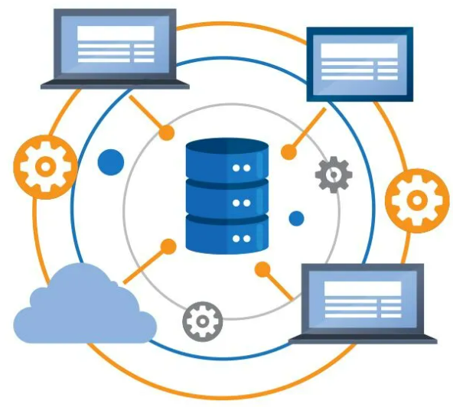
Database Integration
Database integration combines and consolidates information from various sources, including databases, cloud storage, data warehouses, on-prem hardware storage, and more.
This approach makes data accessible across applications, departments, and stakeholders without the risk of data loss or duplication.

Slide 3
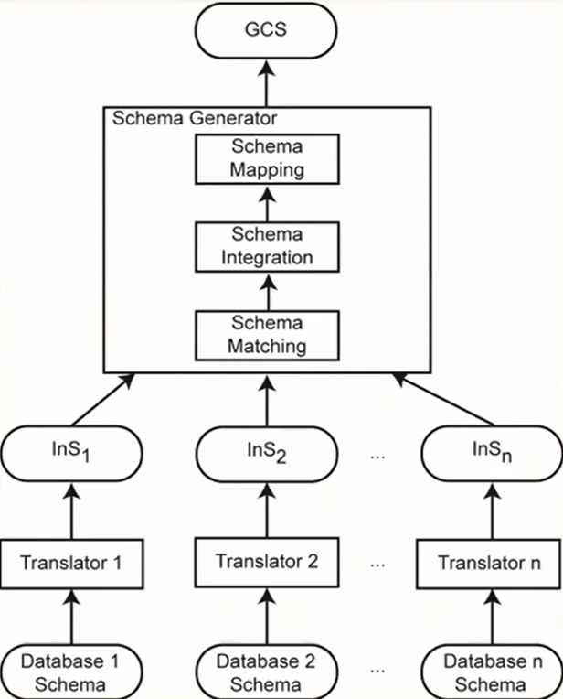
Database Integration Process

Slide 4
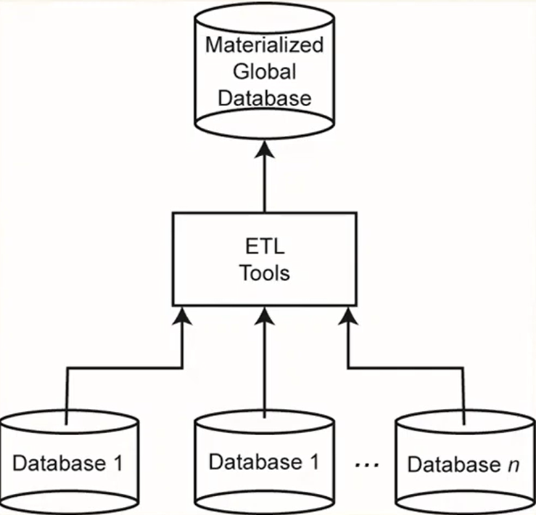

Slide 5
Benefits of Database Integration
Data integration platforms are an efficient approach to data utilization and storage.
The ability to easily access data in a single location saves end-users time and effort and enables cross-departmental collaboration.
Data easily accessed, analyzed, and implemented saves time, money, and effort.
Accessible data is also powerful data. Moving at the speed of business means making intelligent decisions based on relevant, current information.
A centralized location enables organizations to manage enterprise data more effectively and gain more control.
It also ensures peace of mind by simplifying national and global operating standards, compliance, and governance requirements.

Slide 6
Unify Data with Database Integration
Identify the Data Sources
Estimate the Size of Your Data Extraction
Incorporate a Robust Data Integration Platform
Gaining control over information

Slide 7
Database Integration Issues
Schema translation
Component database schemas translated to a common intermediate canonical representation
Schema generation
Intermediate schemas are used to create a global conceptual schema

Slide 8
Schema Translation
What is the canonical data model?
Relational
Entity-relationship
DIKE
Object-oriented
ARTEMIS
Graph-oriented
DIPE, TranScm, COMA, Cupid
Preferable with emergence of XML
No common graph formalism
Mapping algorithms
These are well-known

Slide 9
Schema Generation
Schema matching
Finding the correspondences between multiple schemas
Schema integration
Creation of the GCS (or mediated schema) using the correspondences
Schema mapping
How to map data from local databases to the GCS
Important: sometimes the GCS is defined first and schema matching and schema mapping is done against this target GCS

Slide 10
Schema Matching
Schema heterogeneity
Structural heterogeneity
Type conflicts
Dependency conflicts
Key conflicts
Behavioral conflicts
Semantic heterogeneity
More important and harder to deal with
Synonyms, homonyms, hypernyms
Different ontology
Imprecise wording

Slide 11
Schema Matching
Other complications
Insufficient schema and instance information
Unavailability of schema documentation
Subjectivity of matching
Issues that affect schema matching
Schema versus instance matching
Element versus structure level matching
Matching cardinality

Slide 12
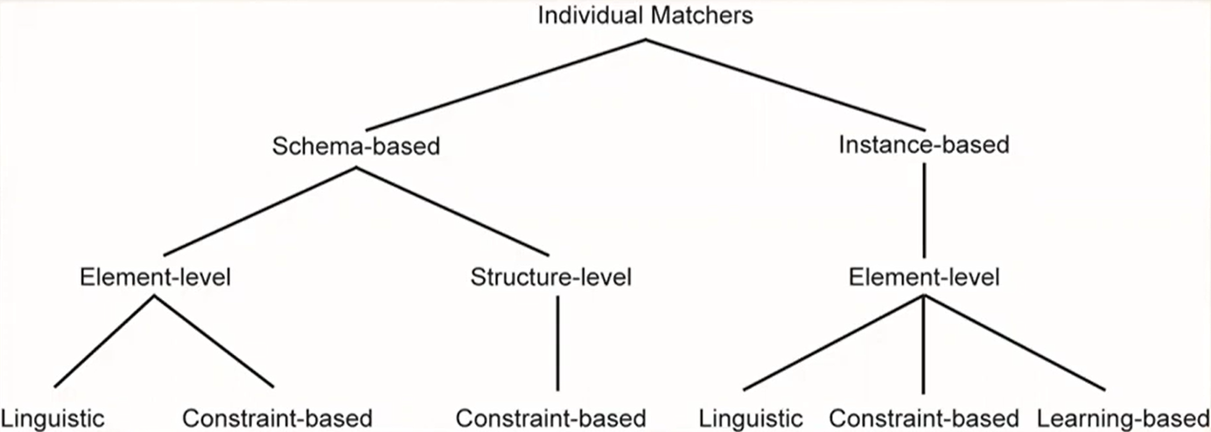
Schema Matching Approach

Slide 13
Linguistic Schema Matching
Use element names and other textual information (textual descriptions, annotations)
May use external sources (e.g., Thesauri)
(SC1.element-1 ≈ SC2.element-2, p,s)
Element-1 in schema SC1 is similar to element-2 in schema SC2 if predicate p holds with a similarity value of s
Schema level
Deal with names of schema elements
Handle cases such as synonyms, homonyms, hypernyms, data type similarities
Instance level
Focus on information retrieval techniques (e.g., word frequencies, key terms)
"Deduce" similarities from these

Slide 14
Linguistic Matchers
Use a set of linguistic (terminological) rules
Basic rules can be hand-crafted or may be discovered from outside sources (e.g., WordNet)
Predicate p and similarity value s
hand-crafted ⇒ specified,
discovered ⇒ may be computed or specified by an expert after discovery
Examples
(uppercase names ≈ lower case names, true, 1.0)
(uppercase names ≈ capitalized names, true, 1.0)
<capitalized names ≈ lower case names, true, 1.0)
<DB1.ASG ≈ DB2.WORKS_IN, true, 0.8)

